Slide 1
Goal Free Problems
Year 6
www.mrbeeteach.com

Slide 2
Place value.

Slide 3
What number is show in the place value chart?
Millions | Thousands |  |  | Ones
O | H | T | O | H | T | O
Multiply the number by 10 and show the answer in a place value chart
Multiply the number by 100 and show the answer in a place value chart
What do you see? What do you know? What could you find out?

Slide 4
0
10
0
10,000
0
10,000,000
Label each division on the number lines.
What numbers are the arrows pointing to?
What is the same and what is different about the number lines?
What do you see? What do you know? What could you find out?

Slide 5
0
10
0
10,000
0
10,000,000
What numbers are the arrows pointing to?
What is the same and what is different about the number lines?
What do you see? What do you know? What could you find out?

Slide 6
Four operations

Slide 7
The perimeter of the triangle is equal to the perimeter of the rectangle. Work out the unknown length of the triangle.
mm
67mm
67mm
160mm
120mm
What do you see? What do you know? What could you find out?

Slide 8
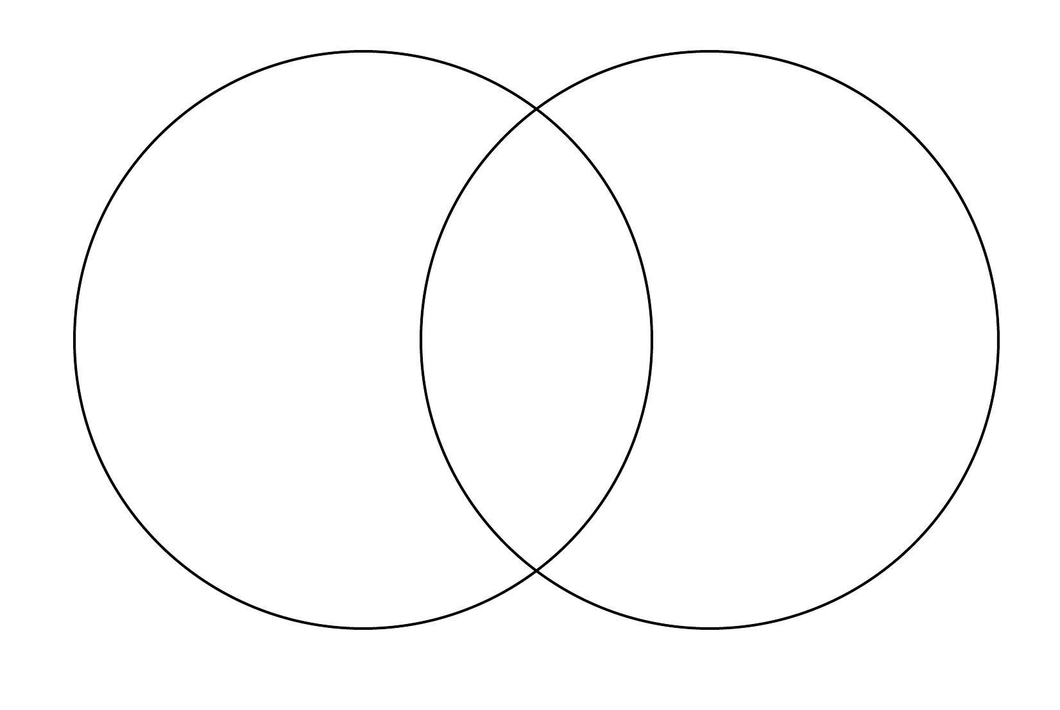
Write the numbers into the Venn Diagram.
1 2 3 4 5 6 7 8 9 10 12 15 24 30
Factors of 24
Factors of 60
What do you see? What do you know? What could you find out?

Slide 9
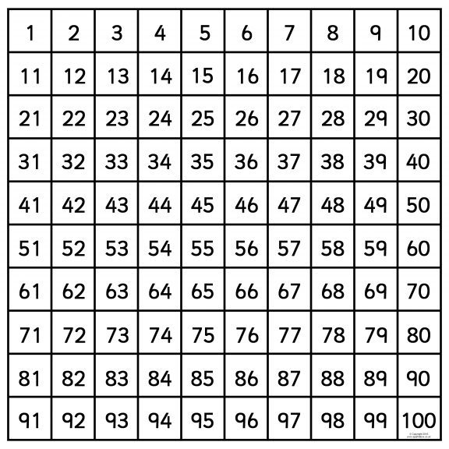
Here is a hundred square.
Shade the multiples of 3.
Circle the multiples of 7.
What are the common multiples of 5 and 6?
What do you see? What do you know? What could you find out?

Slide 10
Here are three bar models. They are not drawn the scale.
2225
A
A
A
A
B
B
B
B
C
C
C
C
C
Work out the value of C.
What do you see? What do you know? What could you find out?

Slide 11
Two digits are missing from the division.
2 7
16
4 3 2
What do you see? What do you know? What could you find out?

Slide 12
What could the numbers be?
1 6
6
9 6
What do you see? What do you know? What could you find out?

Slide 13
What could the numbers be?
r1
1 6
6
9 7
What do you see? What do you know? What could you find out?

Slide 14
Fractions

Slide 15
0
$$\frac{1}{4}$$
$$\frac{2}{4}$$
$$\frac{3}{4}$$
1
1$\frac{1}{4}$
1$\frac{2}{4}$
1$\frac{3}{4}$
2
2$\frac{1}{4}$
2$\frac{2}{4}$
Which fractions are missing?
What do you see? What do you know? What could you find out?

Slide 16
Label the fractions on the number line
$$\frac{5}{10}$$
$$\frac{1}{4}$$
$$\frac{1}{10}$$
$$\frac{1}{8}$$
$$\frac{5}{8}$$
0
1
What do you see? What do you know? What could you find out?

Slide 17
A One the number line, C is 2$\frac{1}{3}$ more than B.
A
B
C
1$\frac{1}{10}$
2$\frac{3}{5}$
4$\frac{14}{15}$
What do you see? What do you know? What could you find out?

Slide 18
Children in year 6 were asked about their favourite day of the week.
The results are shown in the pie chart.
$$\frac{1}{10}$$
$$\frac{1}{5}$$
$$\frac{1}{5}$$
$$\frac{1}{2}$$
What fraction of children do not like Sunday or Monday?
What do you see? What do you know? What could you find out?

Slide 19
Square X and rectangle Y have the same area.
Find the difference between the perimeters.
X
Y
2 $m$
$$\frac{1}{2} m$$
What do you see? What do you know? What could you find out?

Slide 20
Ratio and proportion

Slide 21
Tiles are put into a pattern.
Y | Y | G | G | G | Y | Y | G | G | G
I have 20 more yellow tiles and 24 more green tiles.
Can the pattern continue without there being any tiles left over?
What do you see? What do you know? What could you find out?

Slide 22
These rectangles are similar.
3cm
9cm
Acm
27cm
Calculate the length of A.
What do you see? What do you know? What could you find out?

Slide 23
Algebra

Slide 24
Lynsey has a function machine.
Input
Output
+5
If the input is 10, what is the output?
If the input is 20,000, what is the output?
If the output is 395, what is the input?
What do you see? What do you know? What could you find out?

Slide 25
Complete the function machine.
Input
Output
5
X 5
45
60
What do you see? What do you know? What could you find out?

Slide 26
Complete the function machine.
Input
Output
5
X 10
-10
50
120
What do you see? What do you know? What could you find out?

Slide 27
Decimals

Slide 28
What decimal numbers are the arrows pointing to?
0
1
0
0.2
0
2
What do you see? What do you know? What could you find out?
0
5

Slide 29
Fractions, decimals and percentages.

Slide 30
The bar model is split into tenths.
0.1
The whole has been divided into __________ equal parts.
Each part is worth __________.
As a fraction, this is written ____________.
What do you see? What do you know? What could you find out?

Slide 31
The bar model is split into tenths.
1
0.5 |  |  |  |  |  | 0.5
0.25 |  |  | 0.25 |  |  | 0.25 |  |  | 0.25
0.2 |  | 0.2 |  |  | 0.2 |  | 0.2 |  |  | 0.2
0.1 | 0.1 | 0.1 |  | 0.1 | 0.1 | 0.1 | 0.1 | 0.1 |  | 0.1 | 0.1
1
$$\frac{1}{2}$$ |  |  |  |  |  | $$\frac{1}{2}$$
$$\frac{1}{4}$$ |  |  | $$\frac{1}{4}$$ |  |  | $$\frac{1}{4}$$ |  |  | $$\frac{1}{4}$$
$$\frac{1}{5}$$ |  | $$\frac{1}{5}$$ |  |  | $$\frac{1}{5}$$ |  | $$\frac{1}{5}$$ |  |  | $$\frac{1}{5}$$
$$\frac{1}{10}$$ | $$\frac{1}{10}$$ | $$\frac{1}{10}$$ |  | $$\frac{1}{10}$$ | $$\frac{1}{10}$$ | $$\frac{1}{10}$$ | $$\frac{1}{10}$$ | $$\frac{1}{10}$$ |  | $$\frac{1}{10}$$ | $$\frac{1}{10}$$
0.2 =
0.5 =
$\frac{1}{2}$ =
$\frac{3}{4}$ =
$\frac{8}{10}$ =
What do you see? What do you know? What could you find out?

Slide 32
Here are some hundred squares.
What percent is shaded in each?
What do you see? What do you know? What could you find out?

Slide 33
Area, perimeter and volume.

Slide 34
Find the areas of the rectangles.
2cm
5cm
6cm
10cm
8cm
10cm
What do you see? What do you know? What could you find out?

Slide 35
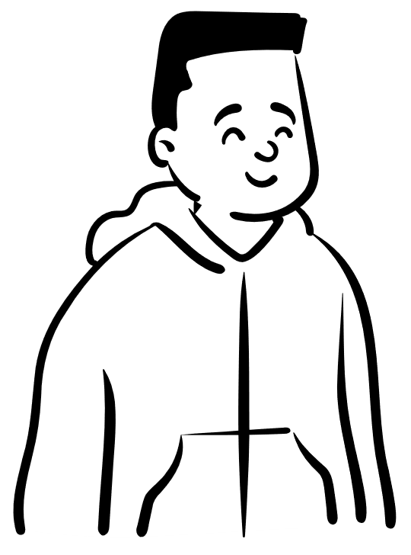
These shapes cannot have the same area, as they look different.
4cm
5cm
2cm
10cm
0.5cm
40cm
Do you agree or disagree?
What do you see? What do you know? What could you find out?

Slide 36
Calculate the area of the shaded triangle.
12cm
3cm
What do you see? What do you know? What could you find out?

Slide 37
Statistics

Slide 38
What is the temperature at 12pm?
Temperature (˚C)
What do you see? What do you know? What could you find out?

Slide 39
This pie charts shows how 800 children favourite colour.
Work out how many children like each colour.
What do you see? What do you know? What could you find out?

Slide 40
The pie charts show the favourite colours of children in two different classes.
True or false?
Fewer children chose red in class 6A than class 6B.
Class 6A
Class 6B
What do you see? What do you know? What could you find out?

Slide 41
Shape

Slide 42
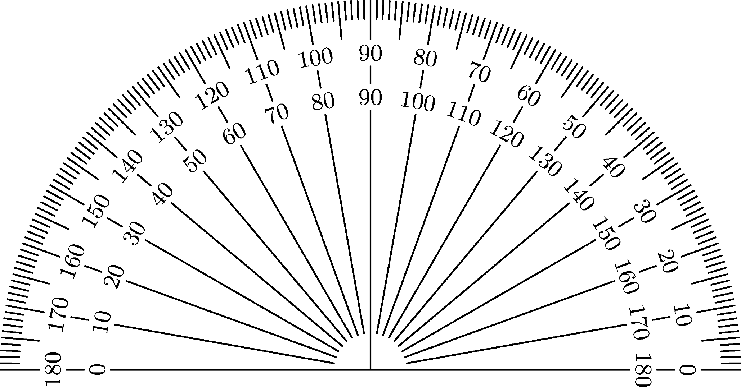
What is the size of the angle?
What do you see? What do you know? What could you find out?

Slide 43
The pie charts shows the items sold in a bakery in a day.
The number of bread sold is equal to the total number of cake and pies sold.
The bakery sold twice as many cakes as it did pies.
Work out the size of the angle for each sector of the pie chart.
What do you see? What do you know? What could you find out?

Slide 44
This diagram is drawn using straight lines.
C˚
A˚
B˚
157˚
Calculate the value of angles A, B and C
What do you see? What do you know? What could you find out?

Slide 45
Calculate the size of angle X in the hexagon.
X˚
What do you see? What do you know? What could you find out?

Slide 46
A line has been drawn from the centre of the circle to its edge.
What is the diameter of the circle?
7cm
What do you see? What do you know? What could you find out?

Slide 47
Geometry – position and direction

Slide 48
Here is a coordinate grid.
B
D
What are the coordinates of A, B, C and D?
C
A
What do you see? What do you know? What could you find out?

Slide 49
www.mrbeeteach.com

