Slide 1
Goal Free Problems
Year 3
www.mrbeeteach.com

Slide 2
Place Value

Slide 3
Here are some digit cards.
3
0
5
Which 3 digit numbers can be made using these digit cards?
What is the greatest 2-digit number that you can make?
What is the smallest 2-digit number that you can make?
What do you see? What do you know? What could you find out?

Slide 4
Where would 25 go on each number line?
0
100
0
50
10
30
What do you see? What do you know? What could you find out?

Slide 5
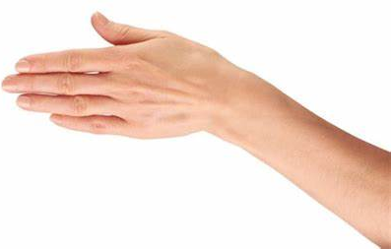
John has used base 10 to make the number 530.
Some of the base 10 pieces are covered up.
Work out the amount covered up.
What do you see? What do you know? What could you find out?

Slide 6
Addition and subtraction.

Slide 7
What do you notice about the bar models?
10
9 | 1
10
80 | 2
100
90
100
80
What do you see? What do you know? What could you find out?

Slide 8
Carl makes this number on the place value chart.
Hundreds | Tens | Ones
He adds three counters. Which numbers could he have made?
What do you see? What do you know? What could you find out?

Slide 9
What mistake has been made?
H | T | O
5 | 2 | 6
2 | 3 | 6
7 | 5 | 12
+
What do you see? What do you know? What could you find out?

Slide 10
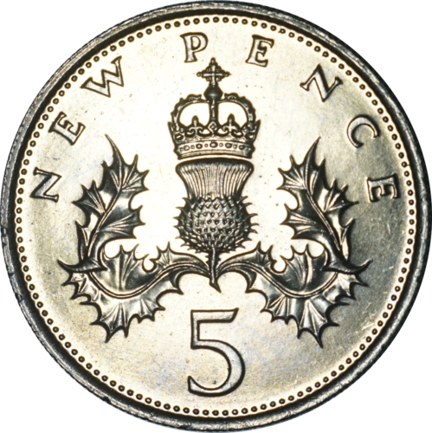
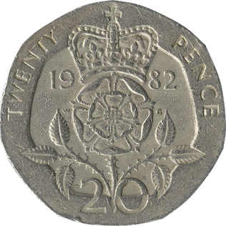
Natalie has £1 in her hands
Which coins could be hidden under her other hand?
What do you see? What do you know? What could you find out?

Slide 11
Multiplication and division.

Slide 12
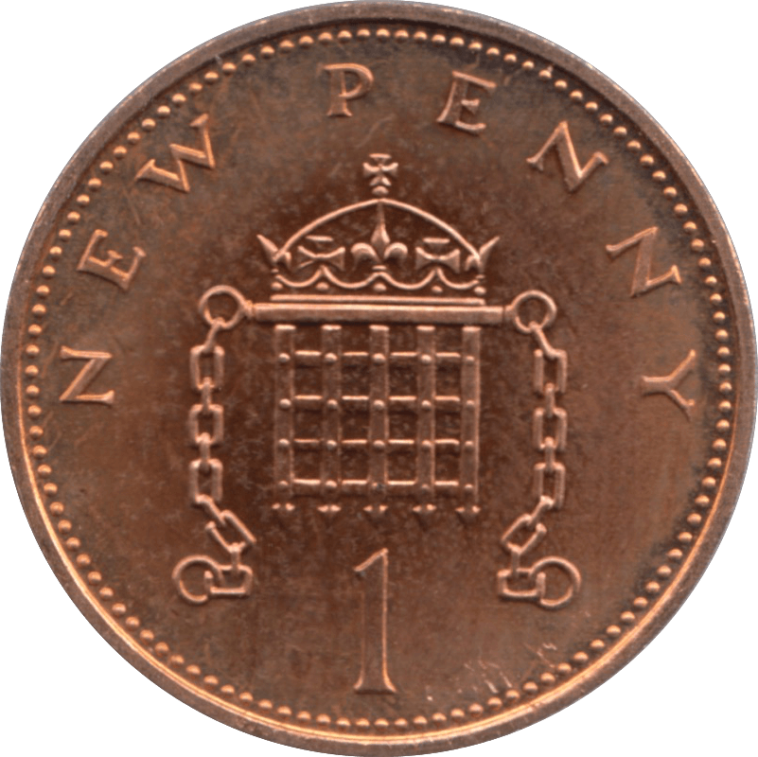
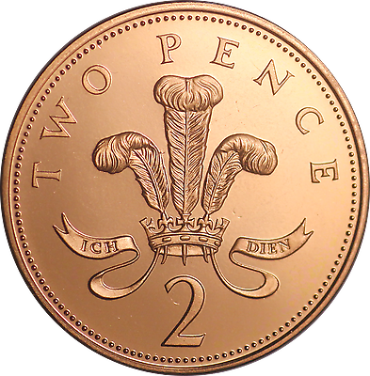
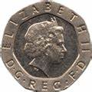
Which is the odd one out?
Which groups are equal / unequal?
What do you see? What do you know? What could you find out?

Slide 13
What do you notice about multiples of 4 and 8?
1 | 2 | 3 | 4 | 5 | 6 | 7 | 8 | 9 | 10
11 | 12 | 13 | 14 | 15 | 16 | 17 | 18 | 19 | 20
21 | 22 | 23 | 24 | 25 | 26 | 27 | 28 | 29 | 30
31 | 32 | 33 | 34 | 35 | 36 | 37 | 38 | 39 | 40
41 | 42 | 43 | 44 | 45 | 46 | 47 | 48 | 49 | 50
51 | 52 | 53 | 54 | 55 | 56 | 57 | 58 | 59 | 60
61 | 62 | 63 | 64 | 65 | 66 | 67 | 68 | 69 | 70
71 | 72 | 73 | 74 | 75 | 76 | 77 | 78 | 79 | 80
81 | 82 | 83 | 84 | 85 | 86 | 87 | 88 | 89 | 90
91 | 92 | 93 | 94 | 95 | 96 | 97 | 98 | 99 | 100
What do you see? What do you know? What could you find out?

Slide 14
Length and perimeter.

Slide 15
What is the lengths of the lines?
What do you see? What do you know? What could you find out?

Slide 16
Each side of the shape is the same length.
If the perimeter is 60cm, how long is each side?
If the perimeter is 120cm, how long is each side?
What do you see? What do you know? What could you find out?

Slide 17
Fractions

Slide 18
There are 2 pieces of ribbon.
Ribbon is folded into 2 equal parts.
Ribbon two is folded into 3 equal parts.
String one
String two
What do you see? What do you know? What could you find out?

Slide 19
Estimate where the fractions would go on the number line.
$$\frac{1}{2}$$
$$\frac{1}{3}$$
$$\frac{3}{4}$$
$$\frac{4}{5}$$
$$\frac{6}{6}$$
0
1
What do you see? What do you know? What could you find out?

Slide 20
Mass and capacity.

Slide 21
Which numbers are the arrows pointing to?
0
100
0
100
What do you see? What do you know? What could you find out?

Slide 22
How much water is in each jug?
5L
5L
4L
4L
2L
2L
3L
3L
2L
2L
1L
1L
1L
1L
What do you see? What do you know? What could you find out?

Slide 23
Fractions (Calculations).

Slide 24
How many ways can you solve the number sentence?
$$\frac{10}{10}$$
$$\frac{}{10}$$
$$\frac{}{10}$$
$$\frac{}{10}$$
=
+
+
What do you see? What do you know? What could you find out?

Slide 25
T$his is \frac{1}{4}$ of the star awards John has.
How many star awards does John have?
What do you see? What do you know? What could you find out?

Slide 26
The sides of the rectangle are whole numbers of cm.
The length is less than 20cm.
The width is $\frac{2}{3}$ of the length.
What measurements could the rectangle have?
What do you see? What do you know? What could you find out?

Slide 27
Money

Slide 28
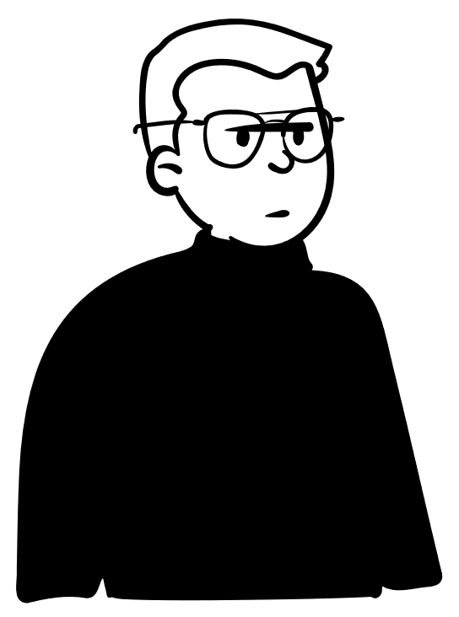
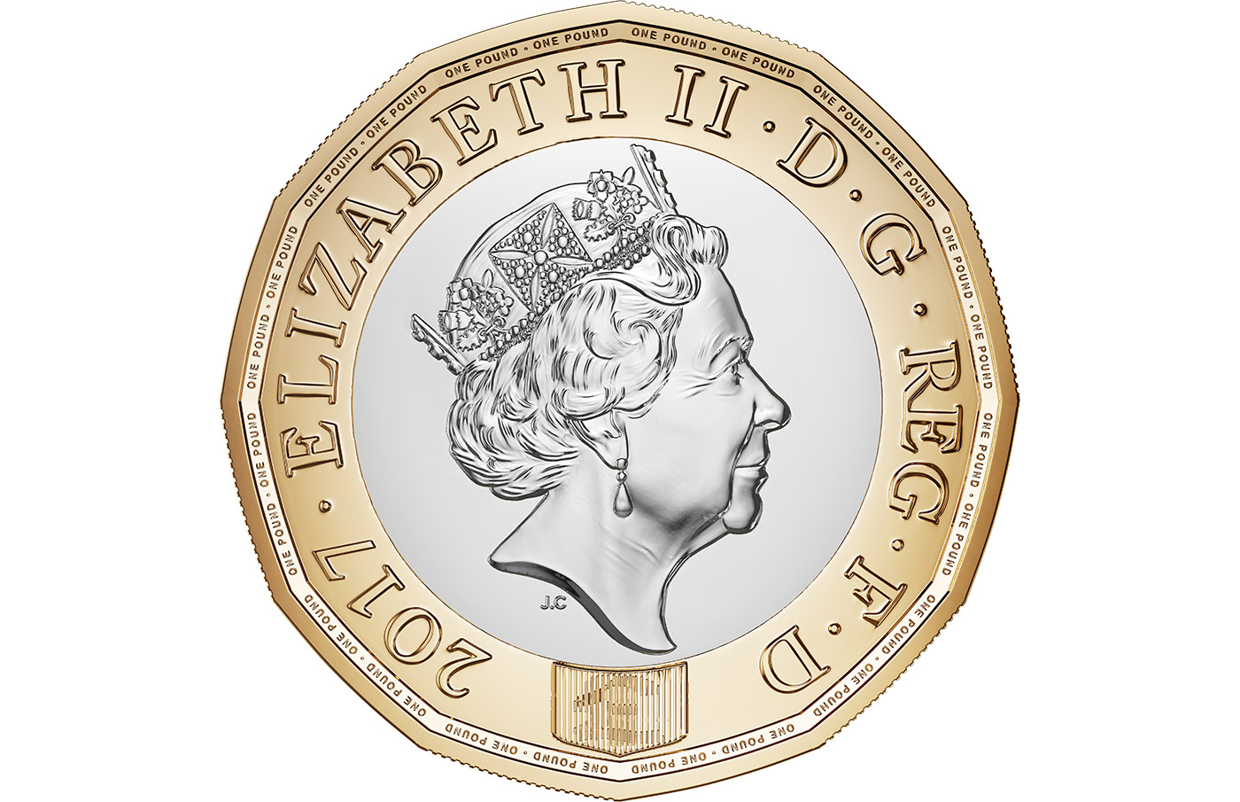
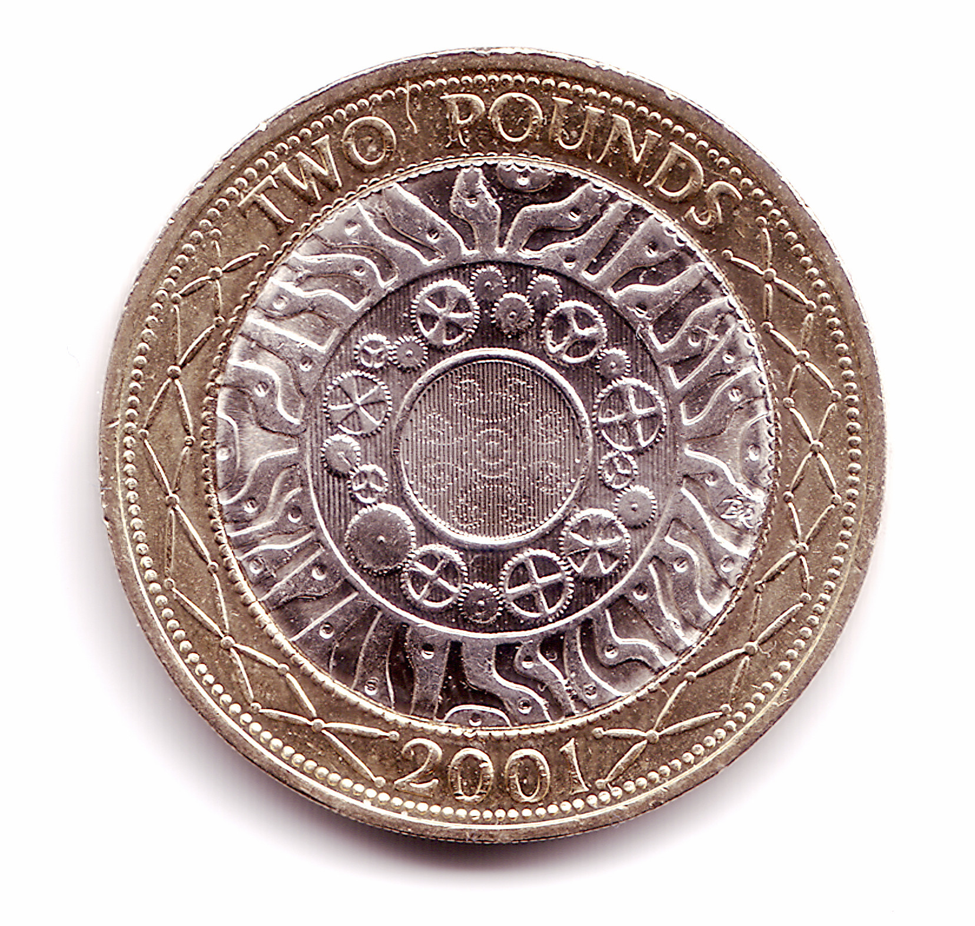
True or false?
There is a £20 note and two coins, so I have £20.02
What do you see? What do you know? What could you find out?

Slide 29
Time

Slide 30
Which Roman numerals are correct?
VIIII
IX
What do you see? What do you know? What could you find out?

Slide 31
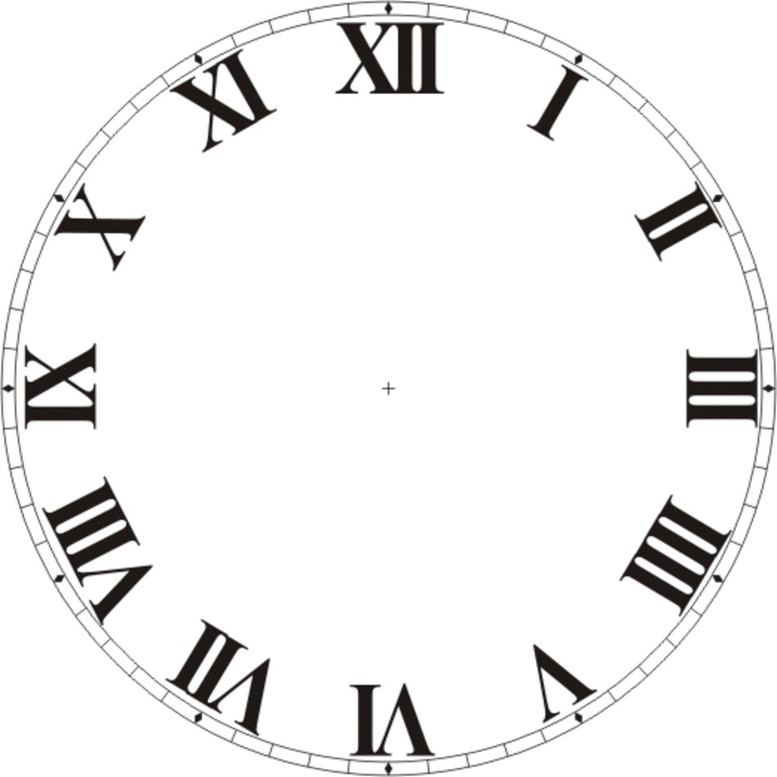
The clock has lost its minute hand. What time could it be?
What do you see? What do you know? What could you find out?

Slide 32
Which month could this be showing?
2024
S | M | T | W | Th | F | S
 |  |  | 1 | 2 | 3 | 4
5 | 6 | 7 | 8 | 9 | 10 | 11
12 | 13 | 14 | 15 | 16 | 17 | 18
19 | 20 | 21 | 22 | 23 | 24 | 25
26 | 27 | 28 | 29 | 30 | 31
What do you see? What do you know? What could you find out?

Slide 33
Shape

Slide 34
The hands on this clock show a right angle.
Which other times would show the hands at right angles?
What do you see? What do you know? What could you find out?

Slide 35
What do the lines measure?
What do you see? What do you know? What could you find out?

Slide 36
Shape

Slide 37
There are 48 children in Year 3.
The pictogram shows how the children of Year 3 get to school.
Walk | Cycle | Train | Car
How many children take the car?
What do you see? What do you know? What could you find out?

Slide 38
The bar chart shows the number of days it rained between January and May.
Which month had the most rainfall?
How many rainy day were there in February?
How many days did it rain from January to May?
Number of days it rained.
Month.
What do you see? What do you know? What could you find out?

Slide 39
www.mrbeeteach.com

