Slide 1

Mastering Geometry
Reception
Autumn term 1
Week 2
Focus: Shape attributes

Slide 2
Session 1

Slide 3



Come and play my round or straight game.
Round

Slide 4
Is it round?
Round

Slide 5
What is the same?
What is different?
Round

Slide 6
Is it round?
Round

Slide 7
Session 2

Slide 8

What is the same?
What is different?
Straight

Slide 9
What is the same?
What is different?
Straight

Slide 10
Are the sides straight?
Can you still see the corners?
Straight

Slide 11
Sort the shapes.
Straight sides | Round sides

Slide 12

Straight sides | Round sides

Slide 13
Session 3

Slide 14
Come and play my round or straight game.
You’ll need to be quick and say if they are round or straight.

Slide 15

Round

Slide 16
Straight

Slide 17
Round

Slide 18

Straight

Slide 19
Round

Slide 20

Round

Slide 21

Round

Slide 22
What is the same?
What is different?

Slide 23
What is the same?
What is different?

Slide 24
What is the same?
What is different?

Slide 25
Session 4

Slide 26
Sort the shapes.
Straight sides | Round sides

Slide 27
Come and play my round or straight game.
You’ll need to be quick and say if they are round or straight.

Slide 28
Round

Slide 29
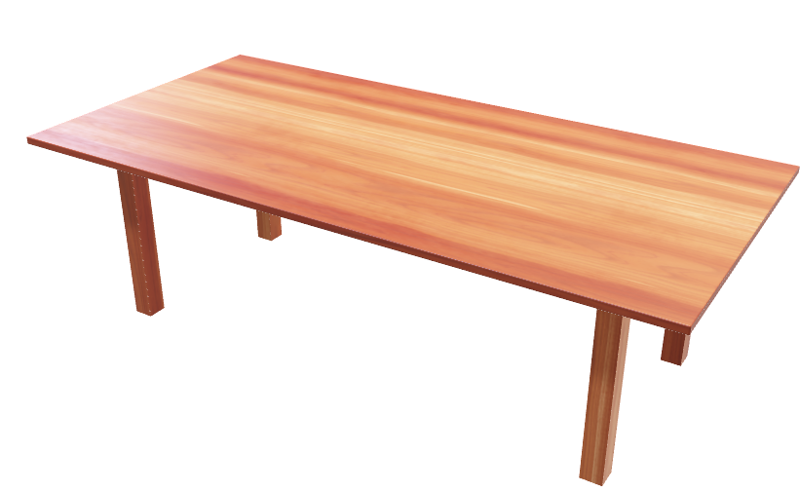
Straight

Slide 30
Round

Slide 31
Straight

Slide 32

Round

Slide 33
Round

Slide 34
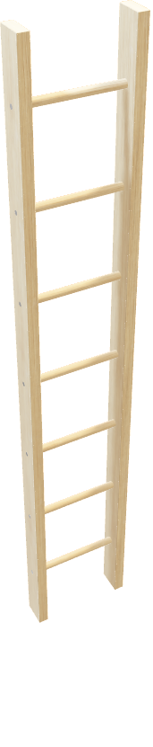
Straight

Slide 35

Round

Slide 36
Straight

