Slide 1

Mastering Geometry
Reception
Summer term 1
Week 27
Focus: Informal measuring tools - cubes, hands

Slide 2
Session 1

Slide 3
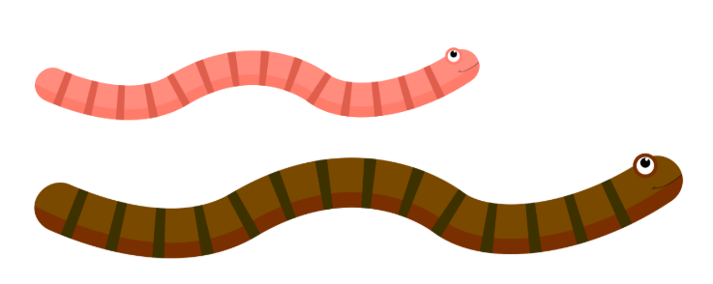
Which is longer?
Which is shorter?
The ___ worm is ___ than the ___ worm.

Slide 4
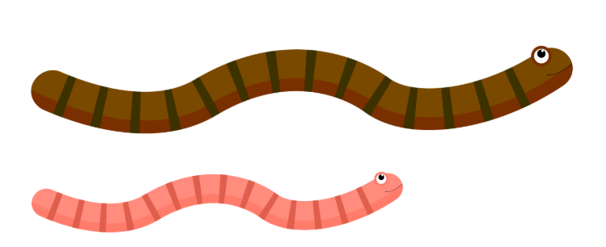
Which is longer?
Which is shorter?
The ___ worm is ___ than the ___ worm.

Slide 5
Which is longer?
Which is shorter?
The ___ ribbon is ___ than the ___ ribbon.

Slide 6
Which is longer?
Which is shorter?
The ___ ribbon is ___ than the ___ ribbon.

Slide 7
The ___ ribbon is ___ than the ___ ribbon.

Slide 10
Session 2

Slide 11
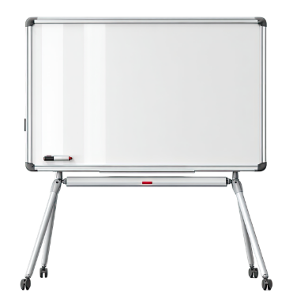

Slide 12


Slide 13


Slide 14
Session 3

Slide 16
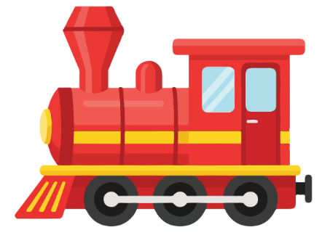

Slide 17
The ___ worm is ___ than the ___ worm.

Slide 18


Slide 19
Session 4

Slide 22
The ___ worm is ___ than the ___ worm.

