Slide 1

Mastering Geometry
Reception
Summer term 1
Week 24
Focus: Comparing lengths [longer/shorter]

Slide 2

Mastering Geometry
Gesture.
Shorter
Longer

Slide 3
Session 1

Slide 4
Which is longer?
Which is shorter?
The ___ ribbon is ___ than the ___ ribbon.

Slide 5
Which is longer?
Which is shorter?
The ___ ribbon is ___ than the ___ ribbon.

Slide 6
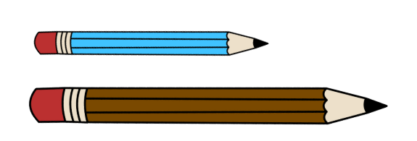
Which is longer?
Which is shorter?
The ___ pencil is ___ than the ___ pencil.

Slide 7
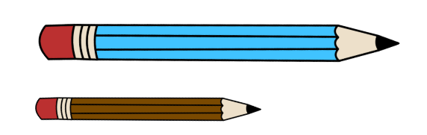
Which is longer?
Which is shorter?
The ___ pencil is ___ than the ___ pencil.

Slide 8
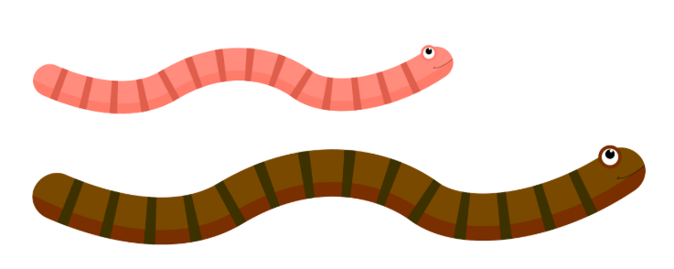
Which is longer?
Which is shorter?
The ___ worm is ___ than the ___ worm.

Slide 9
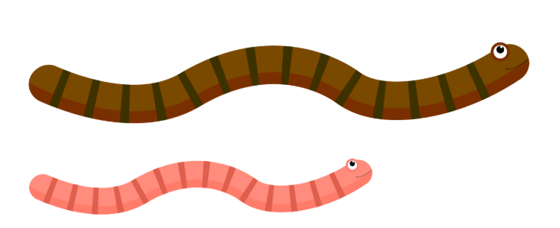
Which is longer?
Which is shorter?
The ___ worm is ___ than the ___ worm.

Slide 10
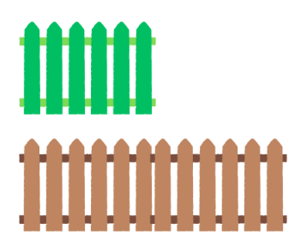
Which is longer?
Which is shorter?
The ___ fence is ___ than the ___ fence.

Slide 11
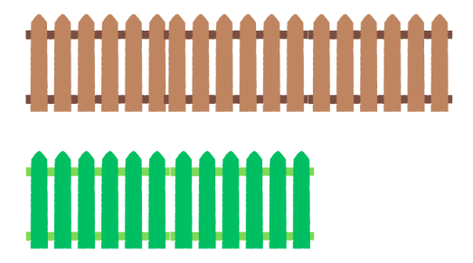
Which is longer?
Which is shorter?
The ___ fence is ___ than the ___ fence.

Slide 12
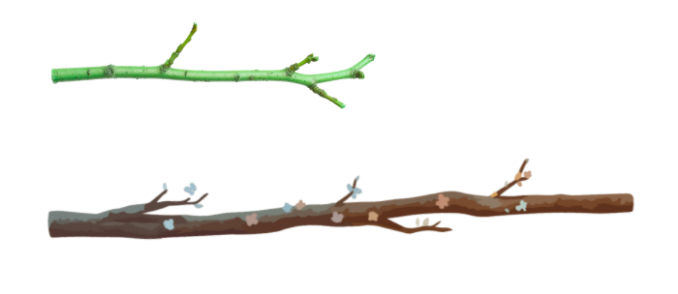
Which is longer?
Which is shorter?
The ___ stick is ___ than the ___ stick.

Slide 13
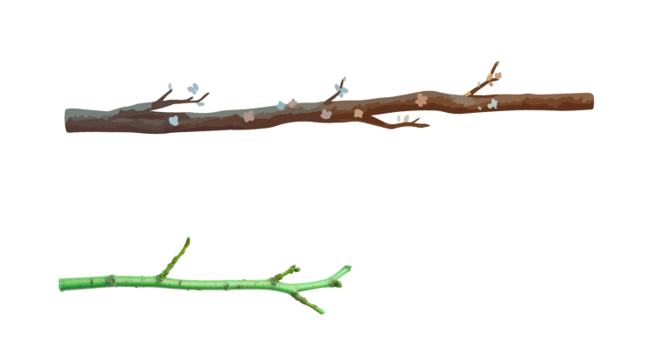
Which is longer?
Which is shorter?
The ___ stick is ___ than the ___ stick.

Slide 14
Session 2

Slide 15
Can we tell which is longer?
The ___ ribbon is ___ than the ___ ribbon.

Slide 16
Can we tell which is longer?
The ___ ribbon is ___ than the ___ ribbon.

Slide 17
Can we tell which is longer?
The ___ pencil is ___ than the ___ pencil.

Slide 18
Can we tell which is longer?
The ___ pencil is ___ than the ___ pencil.

Slide 19
Can we tell which is longer?
The ___ worm is ___ than the ___ worm.

Slide 20
Can we tell which is longer?
The ___ worm is ___ than the ___ worm.

Slide 21
Can we tell which is longer?
The ___ ribbon is ___ than the ___ ribbon.

Slide 22
Session 3

Slide 23
Compare
The ___ ribbon is ___ than the ___ ribbon but ___ than the ___ ribbon.

Slide 24
Compare
The ___ ribbon is ___ than the ___ ribbon but ___ than the ___ ribbon.

Slide 25
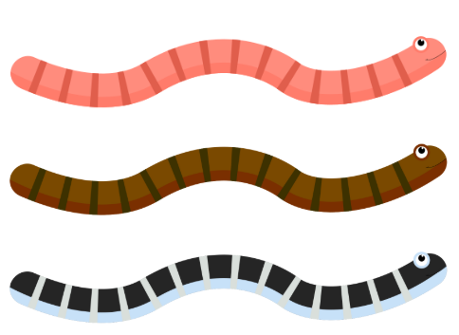
Compare
The ___ worm is ___ than the ___ worm but ___ than the ___ worm.

Slide 26
Compare
The ___ worm is ___ than the ___ worm but ___ than the ___ worm.

Slide 27
Session 4

