Slide 1
Goal Free Problems
Year 4
www.mrbeeteach.com

Slide 2
Place Value

Slide 3
What mistake has been made?
1
10
100
This number is 423
1
10
100
1
100
1
What do you see? What do you know? What could you find out?

Slide 4
True or false?
0
100
The number line is going up in 10s
What do you see? What do you know? What could you find out?

Slide 5
Some counters are placed on the place value chart.
One counter is missing.
List all of the possible numbers that could have been made with the missing counter.
Th | H | T | O
What do you see? What do you know? What could you find out?

Slide 6
What could the start and end numbers be?
2000cm
What do you see? What do you know? What could you find out?

Slide 7
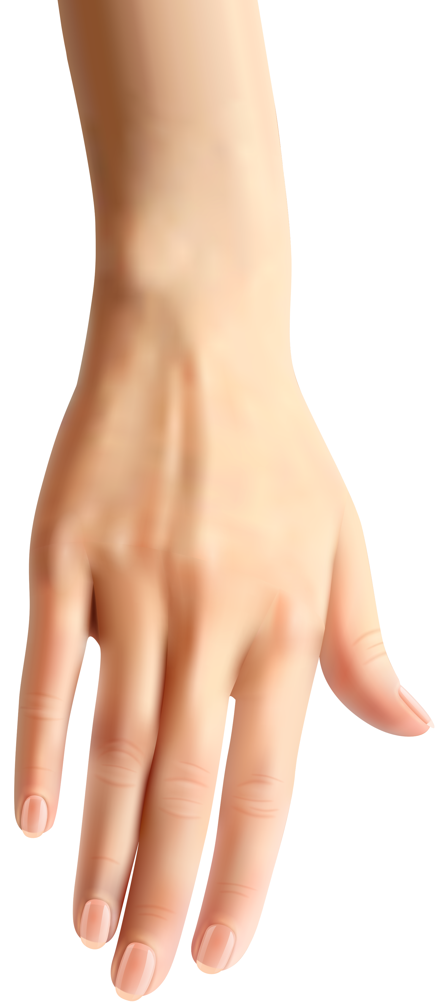
The number line has been covered by a hand.
0
10,000
Which numbers could be hidden under the hand?
Which numbers could not be hidden under the hand?
What do you see? What do you know? What could you find out?

Slide 8
Addition and subtraction

Slide 9
What mistake has been made?
Th | H | T | O
6 | 3 | 5 | 1
1 | 3 | 5 | 2
7 | 6 | 1 | 4
+
1
What do you see? What do you know? What could you find out?

Slide 10
Measurement
Area

Slide 11
Post-it notes are used to cover a book to estimate its area.
Why would this not be accurate?
What do you see? What do you know? What could you find out?

Slide 12
Multiplication and division

Slide 13
Sort the numbers.
33
200
63
102
336
Multiple of 3 | Multiple of 3 and 6 | Not a multiple of 3 or 6
What do you see? What do you know? What could you find out?

Slide 14
True or false?
The area is 15cm² because 5 x 3 = 15.
What do you see? What do you know? What could you find out?

Slide 15
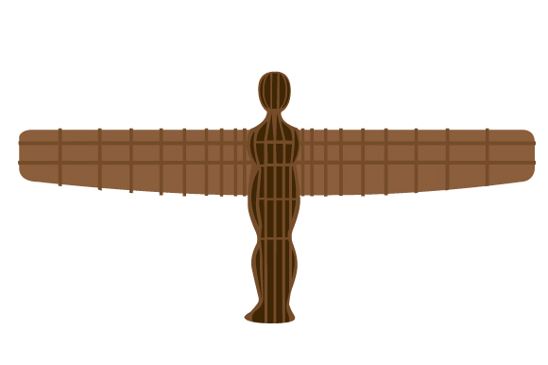
A scaled down model of a monument is shown below.
The actual monument is 100 times bigger.
How big is the original monument?
9cm
5cm
What do you see? What do you know? What could you find out?

Slide 16
Length and perimeter.

Slide 17
Which unit of measure should I use to measure this accurately?
Kilometres or meters
What do you see? What do you know? What could you find out?

Slide 18
Calculate the perimeters on the grids.
What do you see? What do you know? What could you find out?

Slide 19
Which number has the greatest perimeter??
What do you see? What do you know? What could you find out?

Slide 20
Fractions.

Slide 21
Sort the fractions.
$$\frac{1}{10}$$
$$\frac{1}{5}$$
$$\frac{4}{5}$$
$$\frac{9}{10}$$
$$\frac{99}{100}$$
$$\frac{1}{100}$$
Fractions that are a small part of the whole. | Fractions that are a large part of the whole.
What do you see? What do you know? What could you find out?

Slide 22
Which equivalent fractions can you see?
What do you see? What do you know? What could you find out?

Slide 23
Decimals.

Slide 24
Which is the odd one out?
0.1
0.1
0.1
0.1
What do you see? What do you know? What could you find out?

Slide 25
If the Rekenrek is the whole, what fraction is shown on the left.
What do you see? What do you know? What could you find out?

Slide 26
What fraction of each 100 square is shaded?
What do you see? What do you know? What could you find out?

Slide 27
Money.

Slide 28
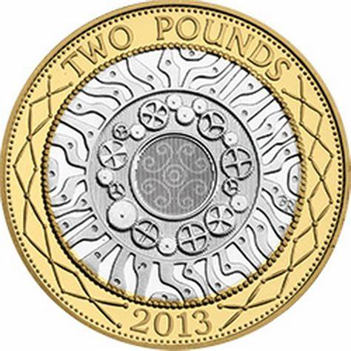
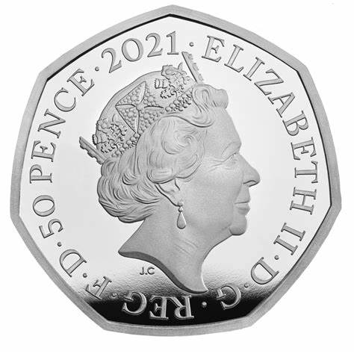
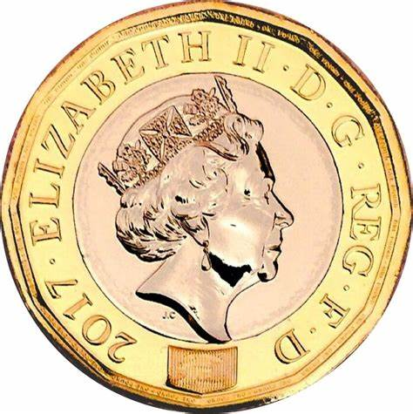
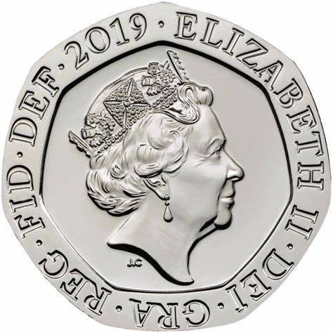
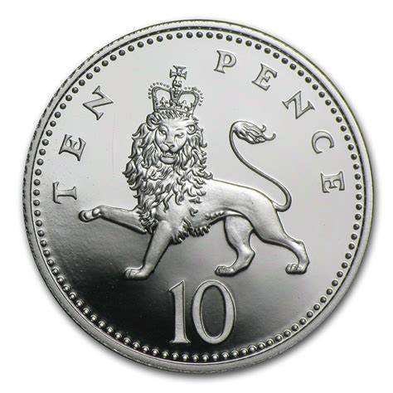
Are the statements true or false?
When added together, the amount can be an odd number of pence.
When added together, the amount is greater than £4.00.
By selecting 3 coins, you can make an amount greater than £3.
By selecting 3 coins, you can make an amount less than 80p.
What do you see? What do you know? What could you find out?

Slide 29
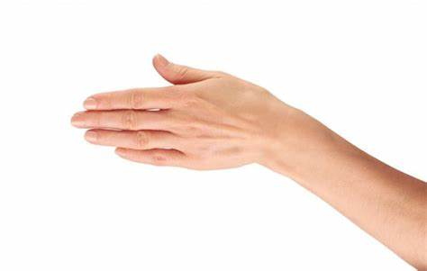
The hand is covering three different coins.
How many different amounts could be covered?
What do you see? What do you know? What could you find out?

Slide 30
Time.

Slide 31
When are John, Carl’s and Lynsey’s birthday?
September.
M | T | W | Th | F | Sa | Su
 |  |  |  | 1 | 2 | 3
4 | 5 | 6 | 7 | 8 | 9 | 10
11 | 12 | 13 | 14 | 15 | 16 | 17
18 | 19 | 20 | 21 | 22 | 23 | 24
25 | 26 | 27 | 28 | 29 | 30
John birthday is the third birthday in September.
Lynsey’s birthday was 10 days after Carls.
Carl’s birthday was on the second Monday in September.
What do you see? What do you know? What could you find out?

Slide 32
Shape.

Slide 33
True or false?
This is a reflex angle.
What do you see? What do you know? What could you find out?

Slide 34
This square has an equilateral triangle inside of it.
The perimeter of the square is 48cm.
Find the perimeter of the triangle.
What do you see? What do you know? What could you find out?

Slide 35
Statistics.

Slide 36
This pictogram shows the colour of children who voted for their favourite flavour of ice-cream.
Flavour | Number of children
Chocolate
Strawberry
Vanilla
Mint
Caramel
= 10 children
How many children liked chocolate ice-cream?
How many children liked mint ice-cream?
How many children liked vanilla ice-cream then strawberry ice-cream?
What do you see? What do you know? What could you find out?

Slide 37
This bar chart shows the countries children in a year group have visited.
How many children visited Ireland?
Number of children
How many children visited Scotland?
How many more children visited England than Wales?
Countries visited.
What do you see? What do you know? What could you find out?

Slide 38
Position and direction.

Slide 39
Points are placed on the coordinate grid.
6
5
4
Which symbol is at (2,5)?
3
Which symbol is at (5,2)?
2
1
Which symbol is at (1,2))?
0
1
2
3
4
5
6
What do you see? What do you know? What could you find out?

Slide 40
www.mrbeeteach.com

