Slide 1
Goal Free Problems
Year 1
www.mrbeeteach.com

Slide 2
Place Value
To 10

Slide 3
What is the same? What is different?
What do you see? What do you know? What could you find out?

Slide 4
Complete the number tracks.
 |  |  |  | 5
 |  | 2 | 3 | 4 | 5
 |  |  |  | 3
What do you see? What do you know? What could you find out?

Slide 5
Addition and subtraction

Slide 6
What is the same? What is different?
What do you see? What do you know? What could you find out?

Slide 7
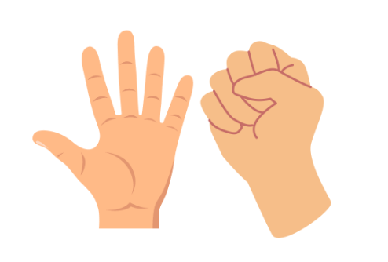
Carl has 10 counters altogether.
How many are in his closed hand?
What do you see? What do you know? What could you find out?

Slide 8
Geometry

Slide 9
Which shape could be hidden?
What do you see? What do you know? What could you find out?

Slide 10
Place Value
To 20

Slide 11
How many ways can you make 10 with 3 addends?
+
+
= 10
What do you see? What do you know? What could you find out?

Slide 12
How many beads have been moved?
What do you see? What do you know? What could you find out?

Slide 13
Which numbers are hidden?
0
1
2
3
4
5
6
7
8
9
10
11
12
13
14
15
16
17
18
19
20
What do you see? What do you know? What could you find out?

Slide 14
Place Value
Within 20

Slide 15
What is 3 + 8?.
0
1
2
3
4
5
6
7
8
9
10
11
12
13
14
15
16
17
18
19
20
Start at 3 and add 8.
Start at 8 and add 3.
What do you see? What do you know? What could you find out?

Slide 16
Place Value
Within 50

Slide 17
Start counting from 25 – 40.
Which numbers would we say out loud?
27
72
31
13
What do you see? What do you know? What could you find out?

Slide 18
Which number has been made?
What do you see? What do you know? What could you find out?

Slide 19
Length and height

Slide 20
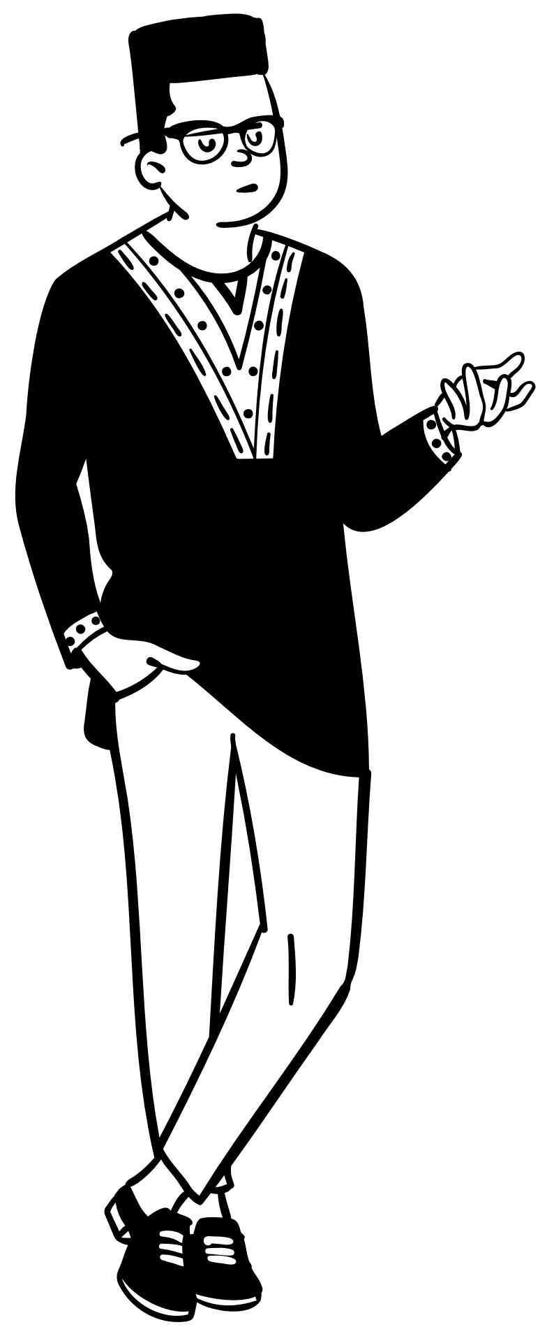
Order the people from shortest to tallest.
John
Carl
Lynsey
What do you see? What do you know? What could you find out?

Slide 21
Mass and volume

Slide 22
Which objects are heaviest?
What do you see? What do you know? What could you find out?

Slide 23
Multiplication and division

Slide 24
Counting in 2s, how many wheels are there?
What do you see? What do you know? What could you find out?

Slide 25
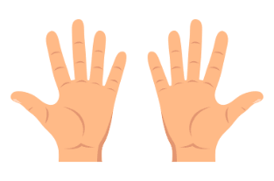
Count in 10s.
What do you see? What do you know? What could you find out?

Slide 26
Part of the array is covered.
How many counters could there be altogether?
What do you see? What do you know? What could you find out?

Slide 27
Fractions

Slide 28
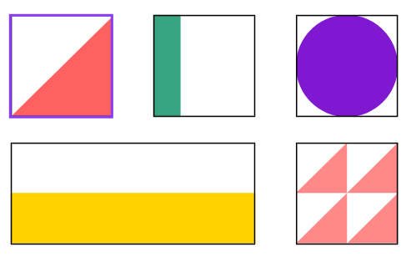
Which shows $\frac{1}{2}$ ?
What do you see? What do you know? What could you find out?

Slide 29
Geometry
Position and direction

Slide 30
The finger has turned.
From which direction could it have turned?
What do you see? What do you know? What could you find out?

Slide 31
The counters have been arranged in a pattern.
Above | Below
Use the language above to describe the position of the colours.
What do you see? What do you know? What could you find out?

Slide 32
Place Value
Within 100

Slide 33
Which numbers are hidden?
1 | 2 | 3 | 4 | 5 | 6 | 7 | 8 | 9 | 10
11 | 12 | 13 | 14 | 15 | 16 | 17 | 18 | 19 | 20
21 | 22 | 23 | 24 | 25 | 26 | 27 | 28 | 29 | 30
31 | 32 | 33 | 34 | 35 | 36 | 37 | 38 | 39 | 40
41 | 42 | 43 | 44 | 45 | 46 | 47 | 48 | 49 | 50
51 | 52 | 53 | 54 | 55 | 56 | 57 | 58 | 59 | 60
61 | 62 | 63 | 64 | 65 | 66 | 67 | 68 | 69 | 70
71 | 72 | 73 | 74 | 75 | 76 | 77 | 78 | 79 | 80
81 | 82 | 83 | 84 | 85 | 86 | 87 | 88 | 89 | 90
91 | 92 | 93 | 94 | 95 | 96 | 97 | 98 | 99 | 100
What do you see? What do you know? What could you find out?

Slide 34
Measurement
Money

Slide 35
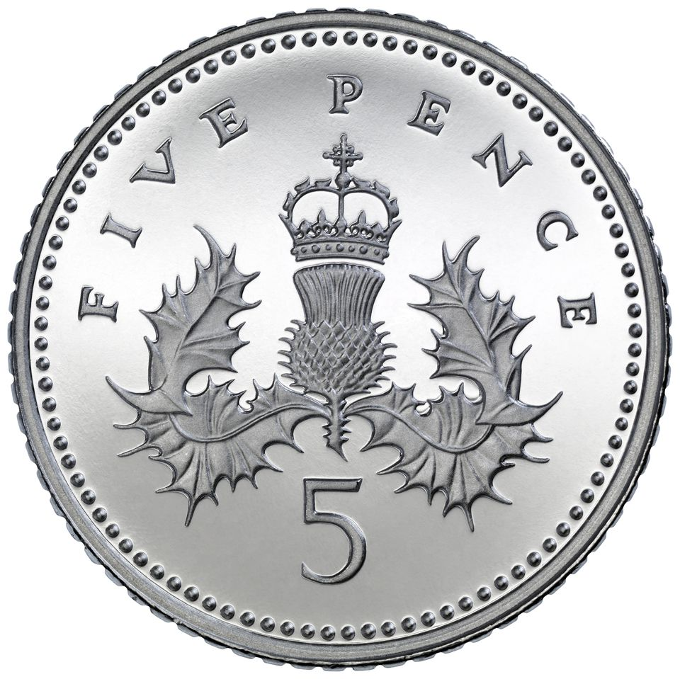
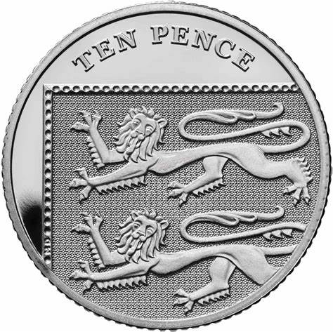
Which coin could the counters match to?
What do you see? What do you know? What could you find out?

Slide 36
Time

Slide 37
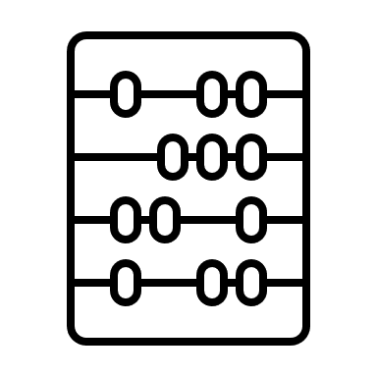
Sort the activities into before and after lunch time.
Home time
Phonics
Science
Maths
What do you see? What do you know? What could you find out?

Slide 38
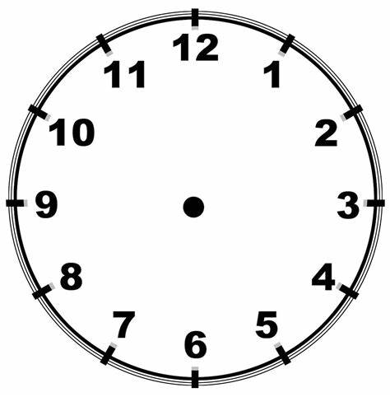
What time does this school start and finish?
What do you see? What do you know? What could you find out?

Slide 39
www.mrbeeteach.com

