Slide 1





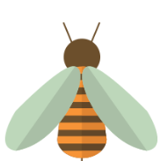







Goal Free Problems
Year 5
www.mrbeeteach.com

Slide 2
Place Value

Slide 3
What number is represented?
TTh | Th | H | T | O
A counter is removed from the tens column. What number is represented now?
A counter is removed from the thousands column. What number is represented now?
What do you see? What do you know? What could you find out?

Slide 4
What number is shown on the Gattegno chart?
100,000 | 200,000 | 300,000 | 400,000 | 500,000 | 600,000 | 700,000 | 800,000 | 900,000
10,000 | 20,000 | 30,000 | 40,000 | 50,000 | 60,000 | 70,000 | 80,000 | 90,000
1000 | 2000 | 3000 | 4000 | 5000 | 6000 | 7000 | 8000 | 9000
100 | 200 | 300 | 400 | 500 | 600 | 700 | 800 | 900
10 | 20 | 30 | 40 | 50 | 60 | 70 | 80 | 90
1 | 2 | 3 | 4 | 5 | 6 | 7 | 8 | 9
Use the chart and find the number 10 times the size of the number shown.
Use the chart to makes the number one-tenth the size of the number shown.
What do you see? What do you know? What could you find out?

Slide 5
Estimate the positions on the number line.
0
1,000,000
A: 250,000
B: Six hundred thousand
C: Five hundred and fifty thousand.
D: 111,111
What do you see? What do you know? What could you find out?

Slide 6
Addition and subtraction

Slide 7
What mental strategies did you use to calculate the questions below?
27 + 39
270 + 390
270 + 399
79 + 79
790 + 790
799 + 799
What do you see? What do you know? What could you find out?

Slide 8
Use the column method to calculate:
 | 7 | 4
+ | 2 | 7
1 | 0 | 1
 | 1
 | 7 | 4 | 7
+ | 2 | 7 | 2
1 | 0 | 1 | 9
 | 1
 | 7 | 4 | 7 | 4
+ | 2 | 7 | 2 | 7
1 | 0 | 2 | 0 | 1
 | 1 | 1 | 1
Which could you have used a mental method for?
What do you see? What do you know? What could you find out?

Slide 9



Mr Pack is buying items for his new home.
His budget is £2500.
TV
£1,200
Lamp
£399
Sofa
£899
If he buys all 3 items, does he have enough money?
What do you see? What do you know? What could you find out?

Slide 10
Multiplication and division

Slide 11
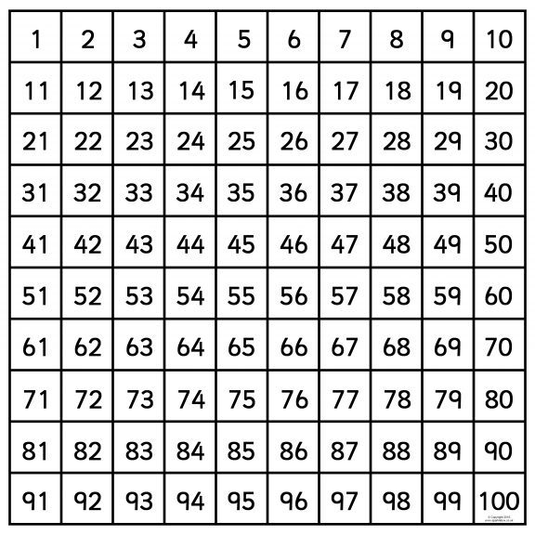
Here is a 100 square.
Shade in the multiples of 5.
Shade in the multiples of 3.
What are the common multiples of 3 and 5?
What do you see? What do you know? What could you find out?

Slide 12
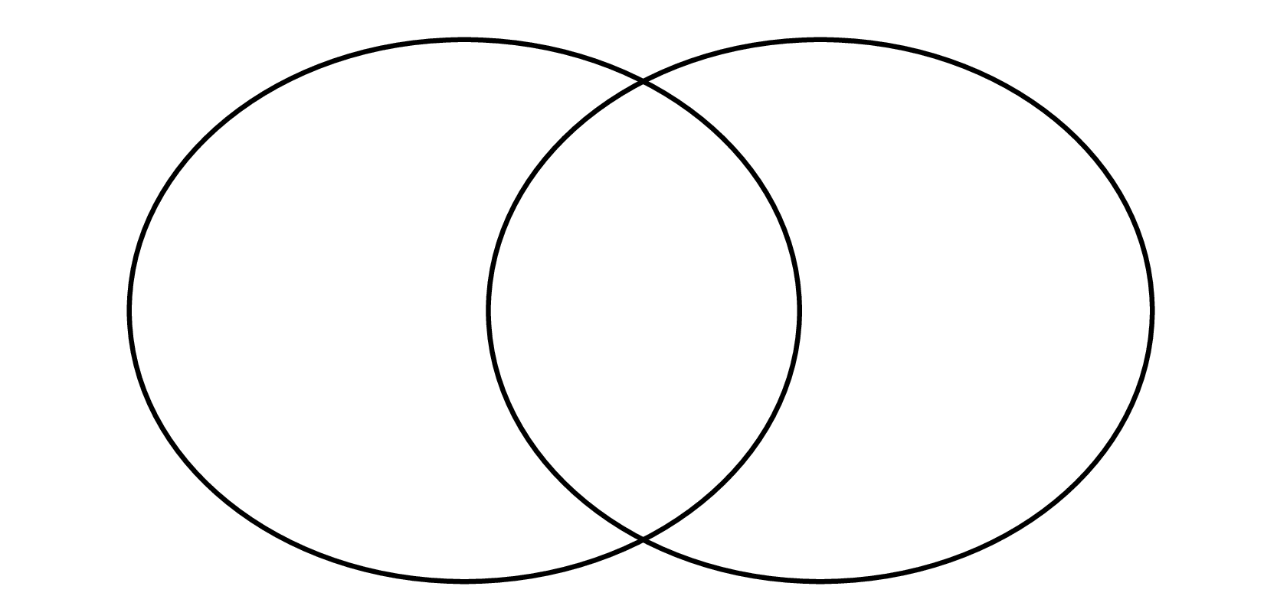
Which numbers are factors of 100?
5
15
25
45
75
90
120
Factors of 5
Factors of 10
What do you see? What do you know? What could you find out?

Slide 13
How do these counters show square numbers?
Use counters to show the next 3 square numbers.
What do you see? What do you know? What could you find out?

Slide 14
Why is the answer to this cubed number not 12?
4
3
What do you see? What do you know? What could you find out?

Slide 15
Use the clues to work out the missing numbers.
 | 2 | 3 | 4 | 5
 |  |  |  | 5 | x
1 | 1 | 7 | 2 | 5
The first factor begins with the digit 2.
The first two digits of the product are the same.
The digits in the first factor are consecutive.
What do you see? What do you know? What could you find out?

Slide 16
What are the missing digits?
 |  | 1 | 2 | 7
 | 5 | 6 | 13 | 35
 |  | 1 | 4 | 5
 | 5 | 7 | 22 | 25
What do you see? What do you know? What could you find out?

Slide 17
Fractions

Slide 18
Which equivalent fractions can you write to match the models?
What do you see? What do you know? What could you find out?

Slide 19

Does this prove that $\frac{1}{2}= \frac{1}{4}$ ?
0
1
0
1
What do you see? What do you know? What could you find out?

Slide 20


Which is greater?
$$\frac{7}{3}$$
$$\frac{3}{7}$$
What do you see? What do you know? What could you find out?

Slide 21
Compare the bar models using >, < or =
What do you see? What do you know? What could you find out?

Slide 22



Order the fractions from smallest to largest.
$$\frac{1}{5}$$
$$\frac{1}{10}$$
$$\frac{1}{2}$$
What do you see? What do you know? What could you find out?

Slide 23
Decimals and percentages.

Slide 24
How many different numbers can you make using 5 counters?
Ones | Tenths | Hundredths
What do you see? What do you know? What could you find out?

Slide 25









Complete the number line
0
0.1
0.2
0.3
0.4
0.5
0.6
0.7
0.8
0.9
1
0
$$\frac{1}{10}$$
$$\frac{2}{10}$$
$$\frac{3}{10}$$
$$\frac{4}{10}$$
$$\frac{5}{10}$$
$$\frac{6}{10}$$
$$\frac{7}{10}$$
$$\frac{8}{10}$$
$$\frac{9}{10}$$
1
What do you see? What do you know? What could you find out?

Slide 26
What fraction and what decimal are shaded?
What do you see? What do you know? What could you find out?

Slide 27
What is the same? What is different?
What do you see? What do you know? What could you find out?

Slide 28
Perimeter and area.

Slide 29


How long is the rectangle?
What do you see? What do you know? What could you find out?

Slide 30
What is the perimeter of the shape?
8cm
5cm
10cm
What do you see? What do you know? What could you find out?

Slide 31
The rectangles are identical.
6cm
2cm
What is the perimeter of the whole shape?
What do you see? What do you know? What could you find out?

Slide 32
Statistics.

Slide 33
This line graph shows the population growth of Sunderland in the UK:
What was the population in 1980?
In which year did the population reach over 350,000 for the first time?
Estimate the year Sunderland reached 300,000.
Population
Year
What do you see? What do you know? What could you find out?

Slide 34
Here is Carl’s timetable for Year 5.
 | Morning task | 9 - 10 | 10 - 11 | Break | 11:15 - 12 | Lunch | 1 – 2:15 | 2:15 – 3:30
Mon |  | English | Maths |  | Reading |  | Science | PE
Tues |  | English | Maths |  | Times tables |  | Computing | PHSCE
Wed |  | English | Maths |  | Reading |  | PE | History
Thur |  | English | Maths |  | Music |  | Geography | Science
Fri |  | English | Maths |  | Reading |  | DT | MFL | Assembly
Which afternoons does Carl have PE?
How many more maths lesson does he have than Science lessons?
What time does History start on a Wednesday?
What do you see? What do you know? What could you find out?

Slide 35
Geometry.

Slide 36

Workout the angle of each turn in degrees.
N
North to East clockwise.
North to South anti-clockwise.
East to North clockwise.
East to North anti-clockwise
NW
NE
W
E
SW
SE
S
What do you see? What do you know? What could you find out?

Slide 37
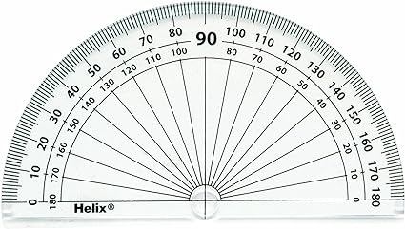

David has measured an angle.
This measures 80˚
Explain why David is incorrect.
What do you see? What do you know? What could you find out?

Slide 38
The rectangles are identical.
3cm
5cm
Calculate the perimeter of the compound shape.
Calculate the area of the compound shape
What do you see? What do you know? What could you find out?

Slide 39
Position and direction.

Slide 40
Two points are plotted on the coordinate grid.
y
8
7
Which point has the coordinates (4,5)?
What is the same and what is different about the other coordinate?
6
A
5
B
4
3
2
1
x
0
1
2
3
4
5
6
7
8
9
10
What do you see? What do you know? What could you find out?

Slide 41
Here is a square on a coordinate grid.
y
8
What are the coordinates of each vertex?
7
6
5
4
3
2
1
x
0
1
2
3
4
5
6
7
8
9
10
What do you see? What do you know? What could you find out?

Slide 42
One vertex of a square has been plotted on a coordinate grid.
y
8
What could its coordinates be?
The square has an area of 8 squares and fits onto the grid. What could its coordinates be now?
7
6
5
4
3
2
1
x
0
1
2
3
4
5
6
7
8
9
10
What do you see? What do you know? What could you find out?

Slide 43
Reflect the triangle in the mirror line.
y
y
8
8
7
7
6
6
5
5
4
4
3
3
2
2
1
1
x
x
0
1
2
3
4
5
6
7
8
9
10
0
1
2
3
4
5
6
7
8
9
10
What do you see? What do you know? What could you find out?

Slide 44
Negative numbers.

Slide 45
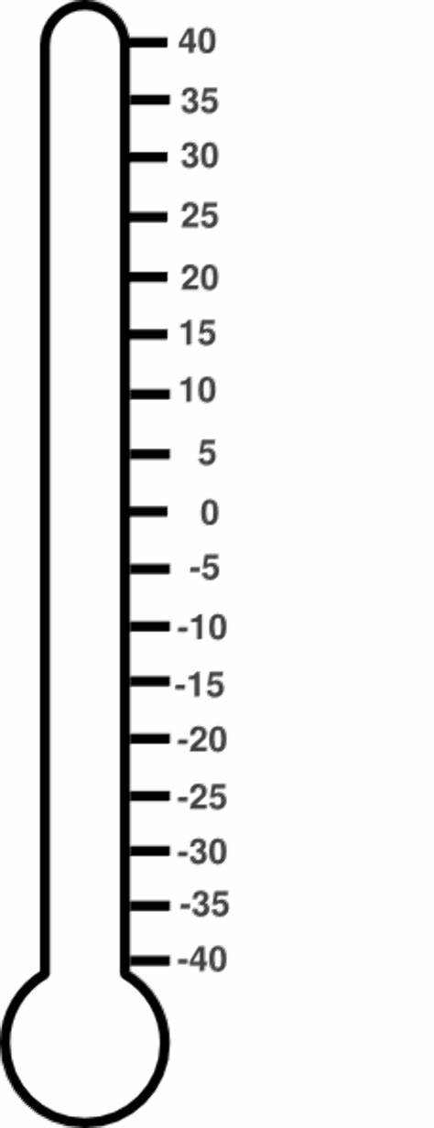
The thermometers show temperatures in Sunderland and London.
The temperature on York is warmer than Sunderland but colder than London.
What could the temperature be?
Sunderland
London
What do you see? What do you know? What could you find out?

Slide 46
Which numbers are the arrows pointing to?
0
3
0
2
0
2
What do you see? What do you know? What could you find out?

Slide 47
Converting units.

Slide 48


A shop buys 1500g of bananas and 2000g of apples.
The shop keeper pays with a £10 note.
How much change does he get?
£1.50 per kg
£2 per kg
What do you see? What do you know? What could you find out?

Slide 49
Measurement (volume).

Slide 50
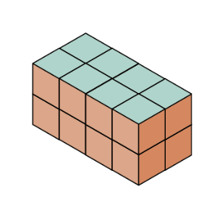
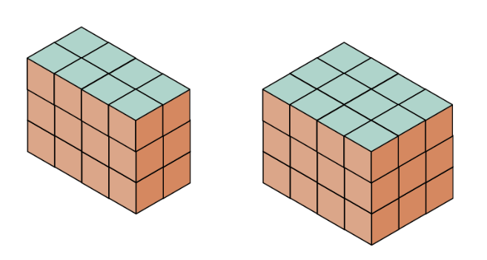
3
Each cube has a volume of 1cm
Each layer if full.
What are the volume of the cubes?
What do you see? What do you know? What could you find out?

Slide 51
www.mrbeeteach.com

